Slide 1
Languages for Learning: A Pedagogy for EAL
Newcastle, UK
10th-11th November 2016
Lecture 3, day 1
Prof Nathalie Auger, Christel Houée, Dr Heidi Layne, Nicu Gal,
Dr Heather Smith, Nancy Corbett
http://research.ncl.ac.uk/romtels/resources/

Slide 2
Translanguaging in Newcastle
Theory – if we raise the status of children’s home languages in the minds of teachers, pupils and families whilst enabling children to use their home languages as a natural part of everyday for learning alongside the language of schooling, this would support more effective learning for bilingual pupils, a more positive relationship between home and school, and therefore a better long term prospect for all concerned.
So, we started with a group of children whose language (and culture) is generally viewed across Europe as low status, comes in many varied dialects, for which there is no standardised written form and about which most teachers know very little. This heterogeneous group of children’s, academic success remains well below the national average across Europe, and their families are often very wary of institutionalised education.
We then dreamed of how to raise the status of this group’s language using very high status technology, which would also help us enable home language use for learning.
The results of this would guide us in dreaming of ways to support all bilingual pupils in whatever context, with or without technology.

Slide 3
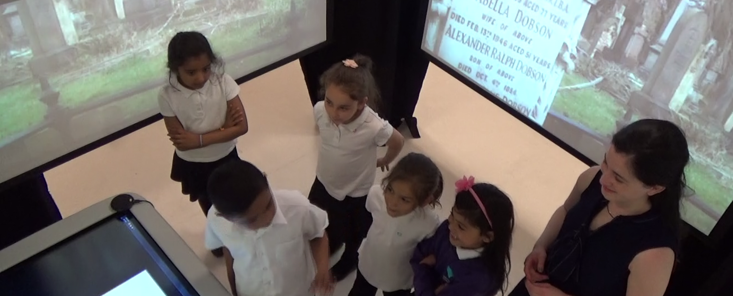
Roma children in Newcastle
 | Slovak Republic | Czech Republic | Romania
Newcastle | 1. East Slovak Romani | Not identified BUT can understand East Slovak Romani | Ursari
 | 2. Czeck Vlax

Slide 4
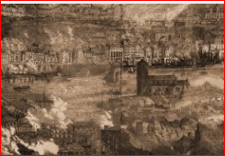
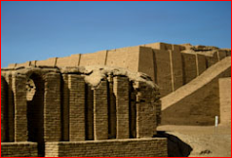
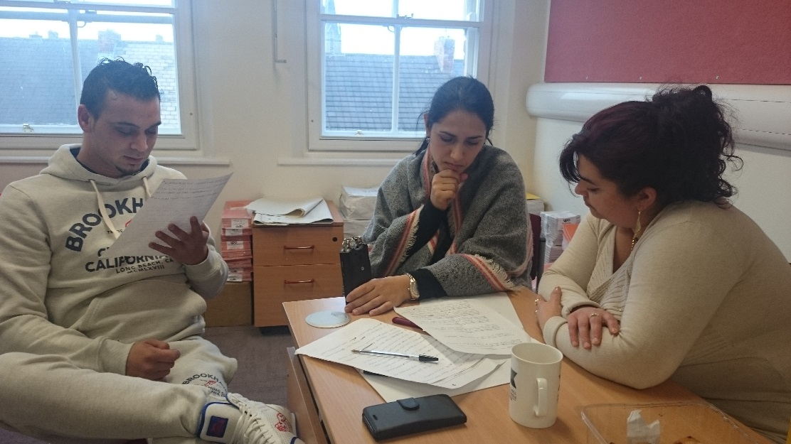
Enquiries written by teachers based on the school’s version of the National curriculum for History (and now PSHE and Science).
Tr4n514ng
Translations and recordings are done by Roma parents in conjunction with an English/Slovak translator, Zaneta (you will meet Marta a parent and Zaneta tomorrow).

Slide 5
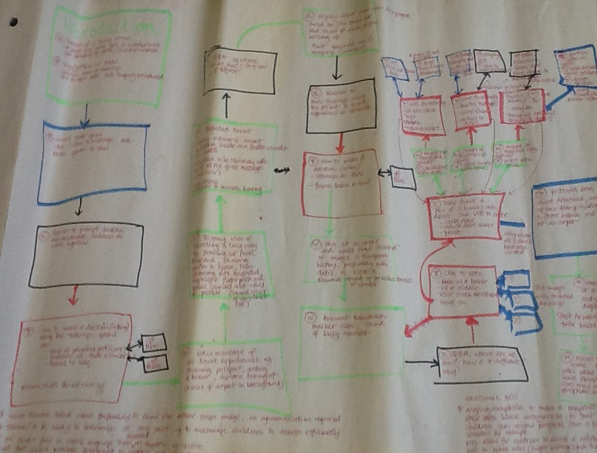
Enquiry Process

Slide 6
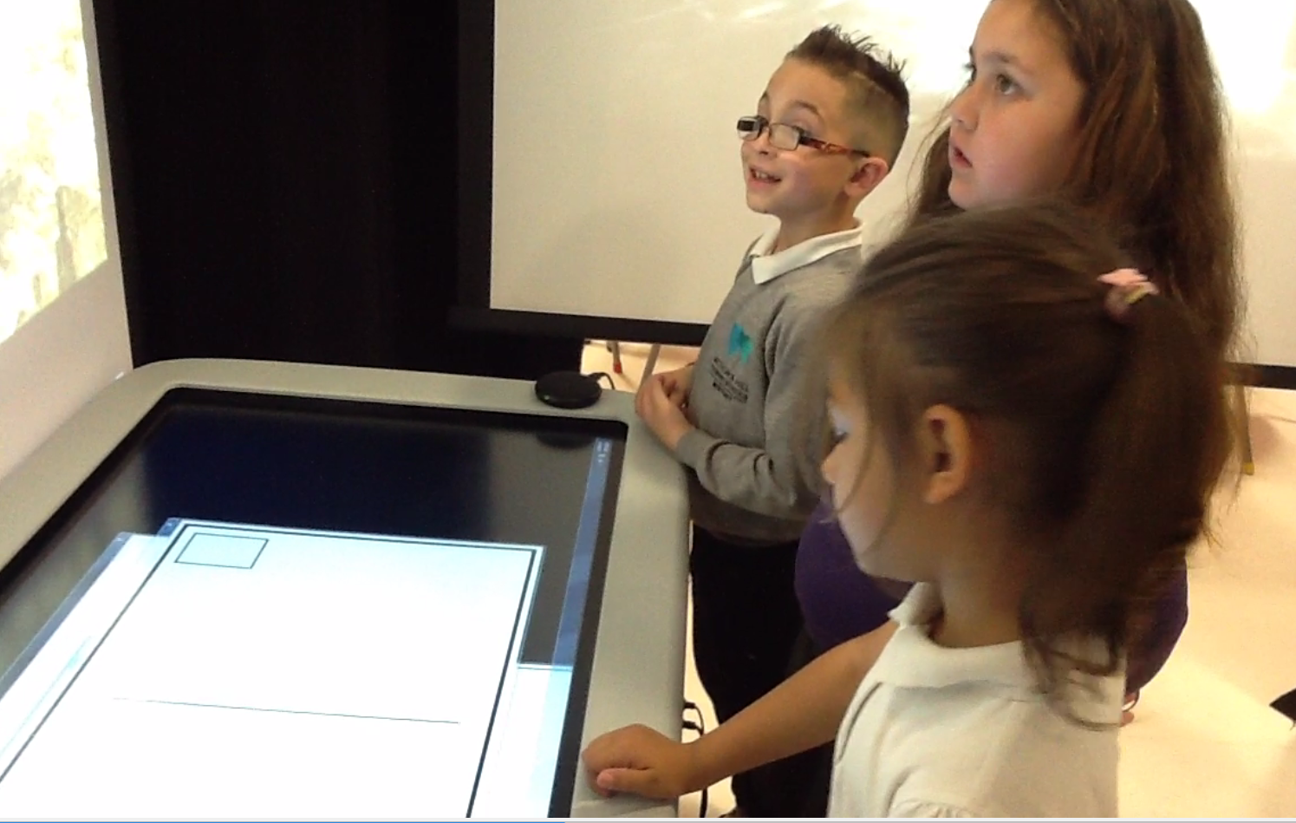
Children work in groups (can be all same language or mixed as would normally be the case, but with at least 2 speakers of the same language and preferably with a good model of English).

Slide 7
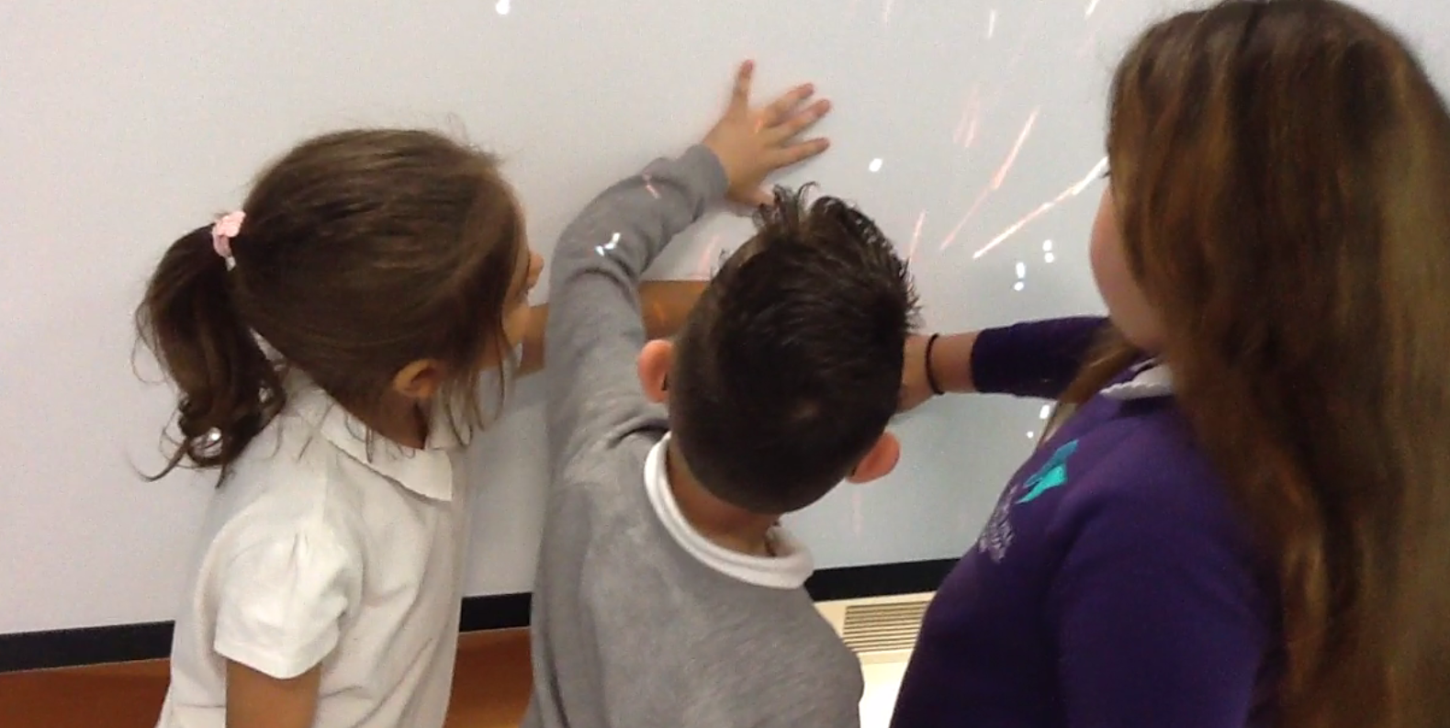
The year 2 (6-7 year olds) classes have been learning about ‘The great fire of Newcastle Gateshead’ The children are given the role of fire investigators. They go back in time to find out who Alexander Dobson was and they must decide who was responsible for starting the fire.
The year 5 children (9-10 year olds) are studying Ancient Baghdad and have been given the role of history investigators. They go back in time to find out what the broken artefact is and to decide whether or not artefacts like that should be taken away from their country of origin.

Slide 8
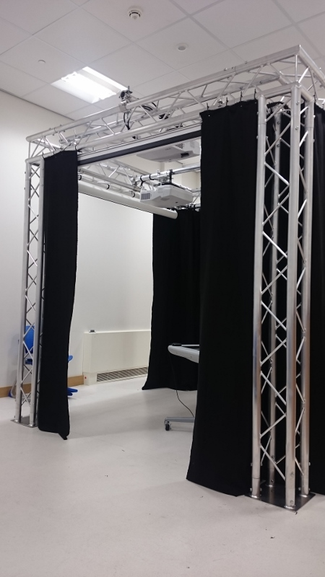
The children work together with a teacher in an enquiry space (bit like a virtual reality space) where videos and imagery are played on all four walls.

Slide 9
Along the way they meet lots of characters who give them tasks to do which provide clues for their investigations, at the same time teaching them about the subjects! The characters always play on the front screen. These tasks are on the interactive tabletop, along with some tools to help the children collect evidence. There are also physical tools such as an atlas, visa applications for travel to Baghdad, and a flying carpet.
So, let’s see some examples of what happens

Slide 10
Finnish Roma children:
“West European Roma”
The original Finnish Kale – moved to Finland from Sweden via Scotland and Northern England
Languages spoken: Finnish Roma, Finnish Kale/ Romani
Year 2010-2011 total of 149 to179 Roma pupils were taught Romany (Finnish Kale) at school (National Board of Education report, 2011: 97)

Slide 11
Finnish Roma children in schools:
Finnish education has been accessible to Finnish Roma people only the past 30 years
Today Finnish Roma children in schools are only the second generation of Roma children who have been able to access the schools

Slide 12
Finnish Roma children in schools:
Children often placed in a special education without diagnostics of learning disabilities
The school results for Roma children do not necessarily respond to their abilities to perform in school – Roma children follow their traditional celebrations that are not the same to the Finnish school system
(National Board of Education report, 2011: 26)

Slide 13
Eastern European Roma children in Finnish schools:
No statistics about the number of children in schools – estimation by the Finnish Roma Forum is approximately 50 children in the whole Finland
ROMTEL schools in Järvenpää
2-4 children of Eastern European Roma origin: Children in a preparatory classroom an in special education classroom
Based on the observations the schools do not support home language use during teaching

Slide 14
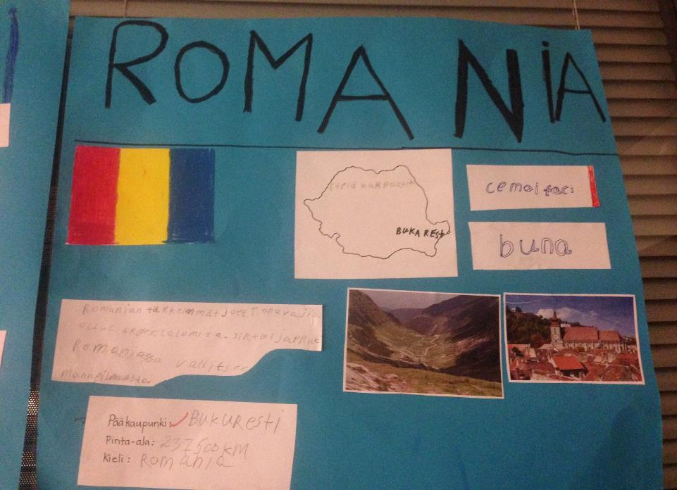

Slide 15
Language identified to be Ursari (Romania) for 4 children in Järvenpää:

Slide 16
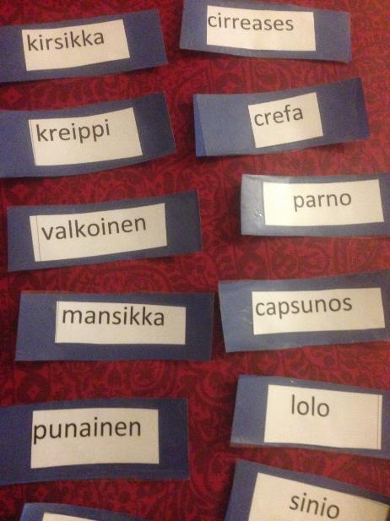
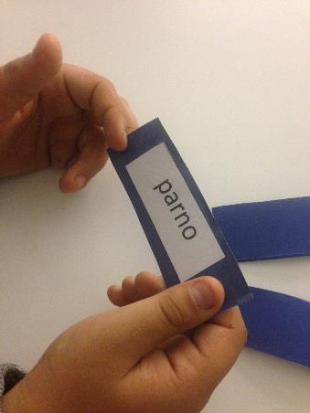
Memory
game

Slide 17
OTHER ACTIVITIES:
“Toolkits” for home language use for teachers
Story book project with Romani Forum in Finland to involve the parents
TEACHER’S PROFESSIONAL DEVELOPMENT for the city of Helsinki and for the teachers in Järvenpää schools

